Slide 1
Music
Generation
Hunter Hsieh, Hsien Fang Liu,
Tsung-Min Huang
CMPE 256 Large-Scale Analytics

Slide 2


Introduction
Notes:
Nowadays, Ai-generated art has become one of the most popular topics. Ａ well-known example is transforming a picture into Van Gogh’s style image. This gave us an idea that how will the music be like if we let the machine to compose music. To do that, we have to analyze tons of music and find the general pattern. There are many ways to do that, and we chose neural network.

Slide 3
Introduction
Dataset
Piano dataset from “Neural Translation of Musical Style”
Method
Feature Engineering
Generative Adversarial Network (GAN)
Notes:
Using images as input is a very common way in machine learning field. In our project, we transformed music to a 2D image to be our input data by using short-time Fourier transform.
For better quality of generating some new data, we chose GAN for our network.

Slide 4
Feature Engineering
Mel Frequency Spectrum (MEL)
Difficult to inverse
back to audio
Constant Q Transform (CQT)
Short Time Fourier transform (STFT)
Notes:
Transforms a data series to the frequency domain
MEL representation of the short-term power spectrum of a sound, based on a linear cosine transform of a log power spectrum on a nonlinear mel scale of frequency.
CQT it is a type of wavelet transform
STFT is a Fourier-related transform used to determine the sinusoidal frequency and phase content of local sections of a signal as it changes over time.

Slide 5
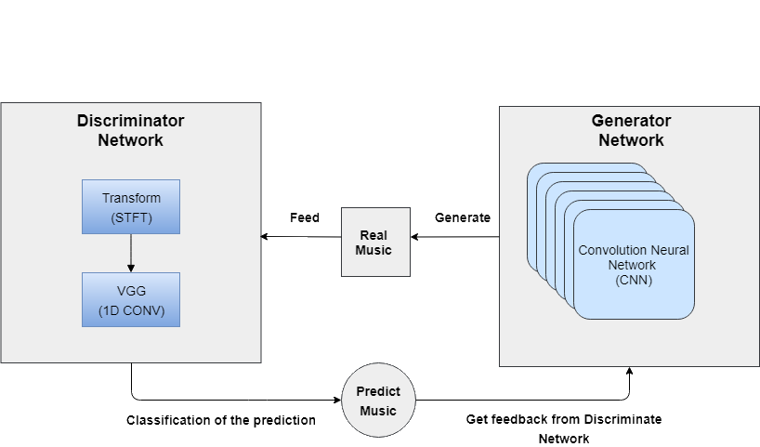
GAN Architecture
Discriminator Network:
Validated the generated music
Generator Network:
Generate new music from
Gaussian noise

Slide 6
Discriminator Network Design
Initial layer:
Down Sample 2D Spectrum image.
Extra layer:
1D convolution along time axis.
Pyramid Layer:
Feature extraction along time and frequency.
Final Layer:
Leverage the input is similar to real sample.
Initial Layer
Extra Layer
Pyramid Layer
Final Layer

Slide 7
Generator Network Design
Initial layer:
Convert Gaussian noise to feature representation.
Pyramid layer:
Transpose convolution operation to unfold noise as
feature representation along time and frequency axis.
Extra Layer:
Transpose convolution along the time axis.
Final Layer:
Generate fake samples.
Initial Layer
Pyramid Layer
Extra Layer
Final Layer

Slide 8
Experiment
Preprocessing:
MIDI to mp3 (44.1KHz)
Down Sampling (44.1KHz -> 2KHz)
Random slice 32 seconds
STFT
FFT windows: 128
Half overlap width: 64

Slide 9
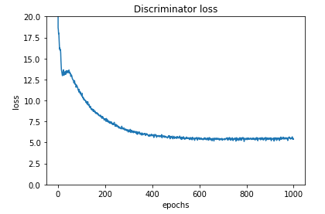
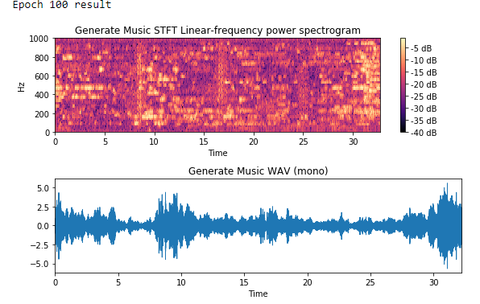
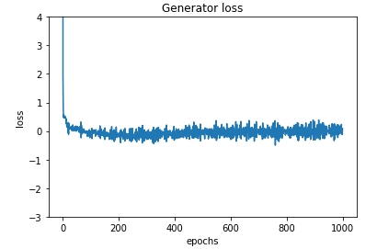
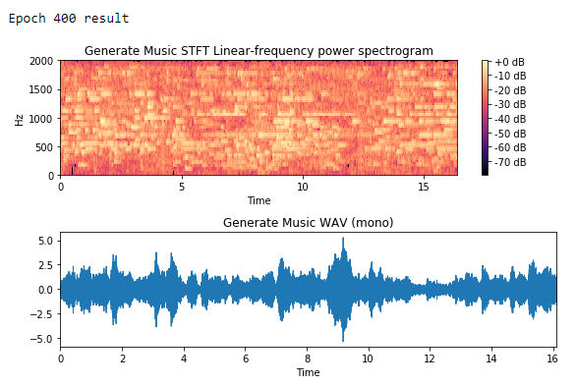
Experiment

Slide 10

Demonstration
Generated music with Epoch 100:
Generated music with Epoch 400:
Generated music with Epoch 1000:

Slide 11
Demonstration
Generated music with Epoch 1000:
MIDI conversion

Slide 12
Conclusion
We demonstrate that music can be generated from spectrum image.
Audio quality increases along with the number of epochs
Network architecture optimization
Deeper convolution layer
Different feature representation:
Wavelet transform

